Slide 1

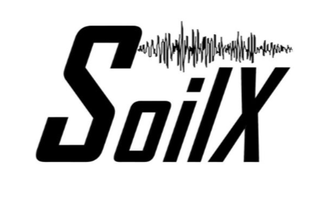

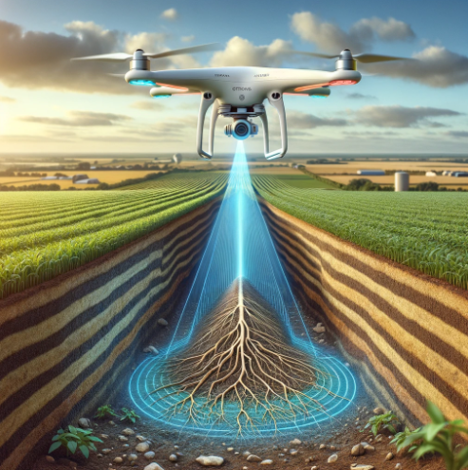
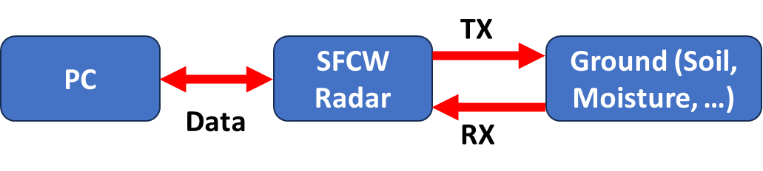
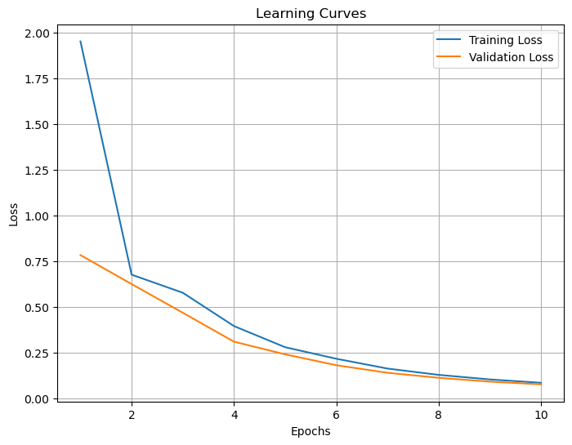
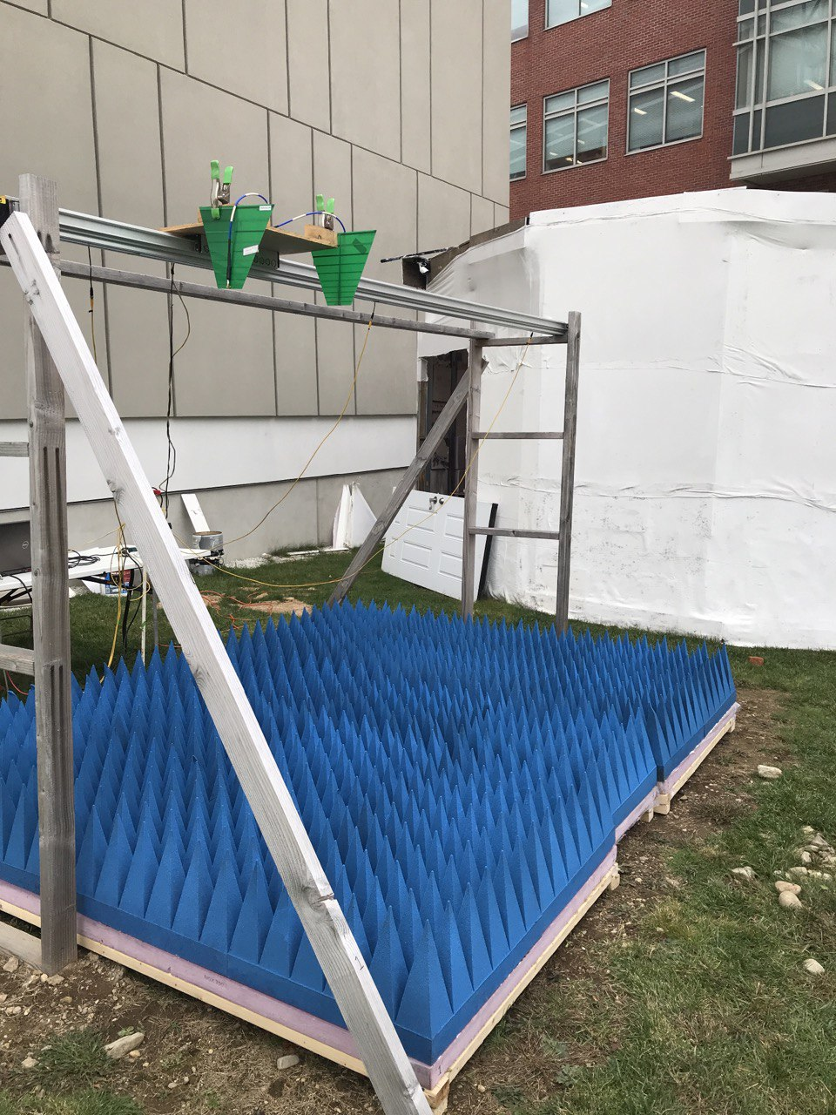
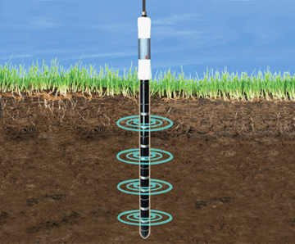
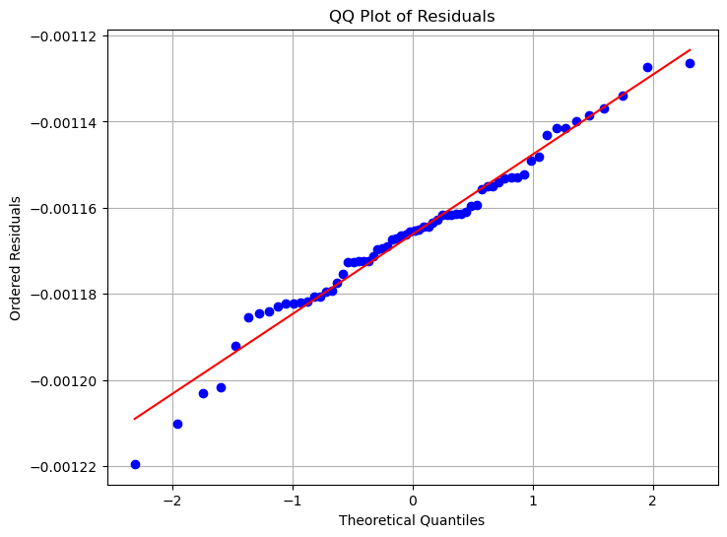
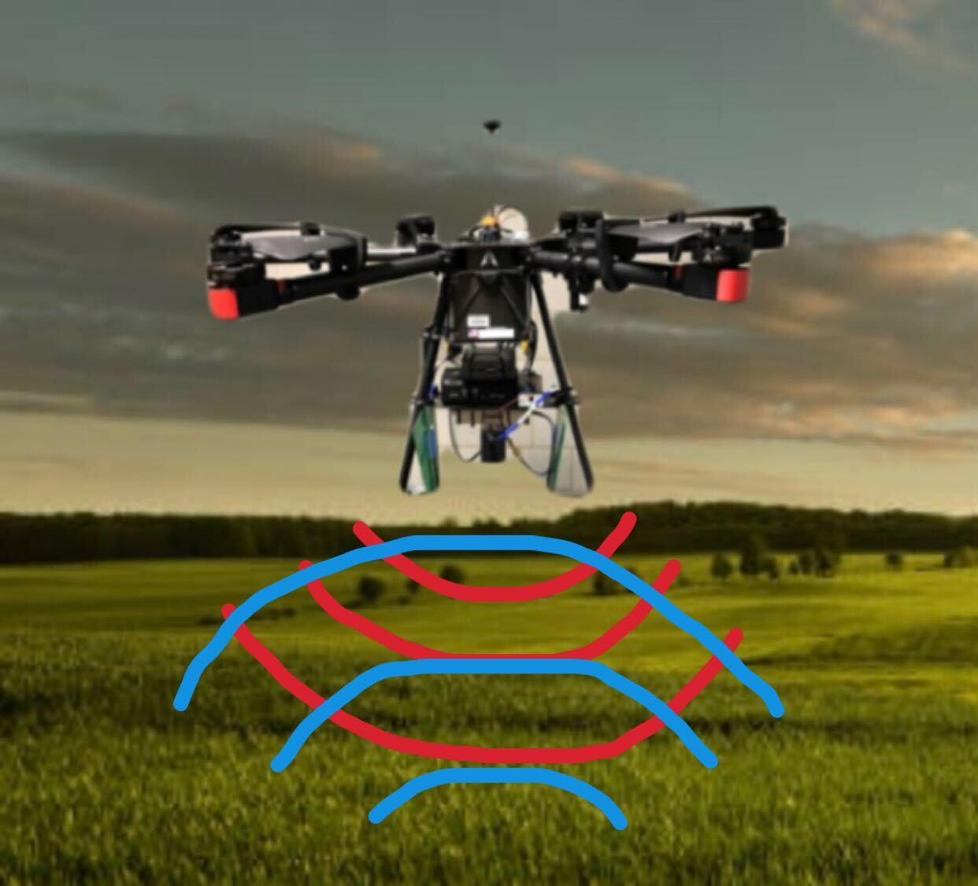

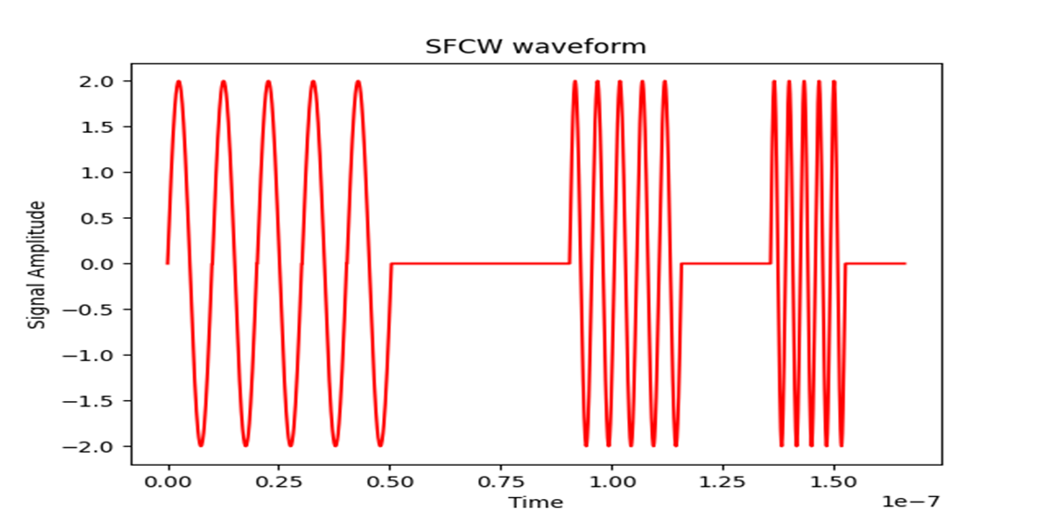
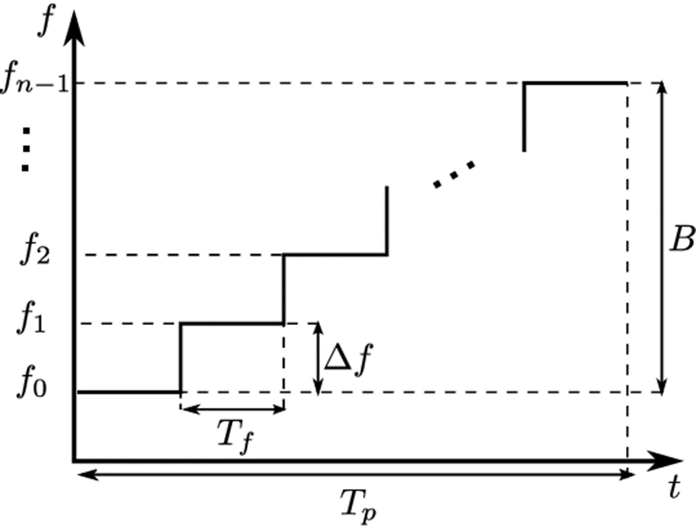

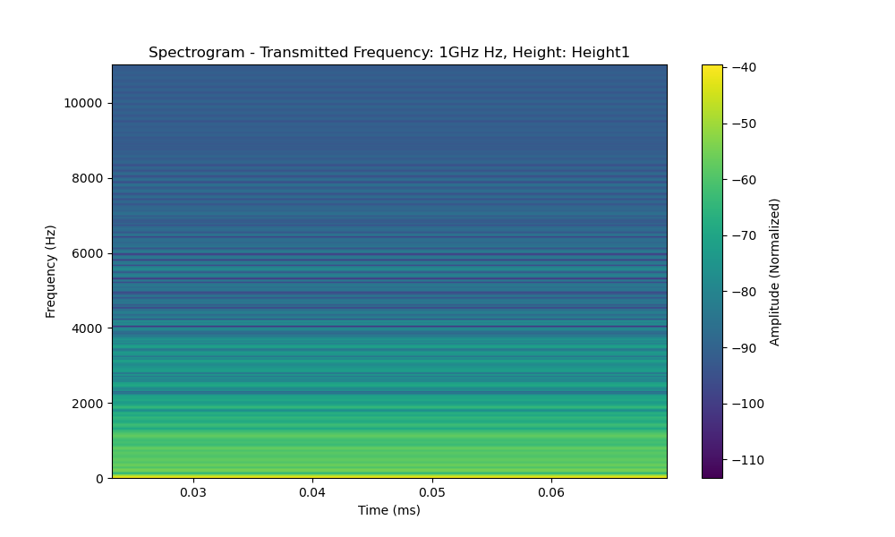
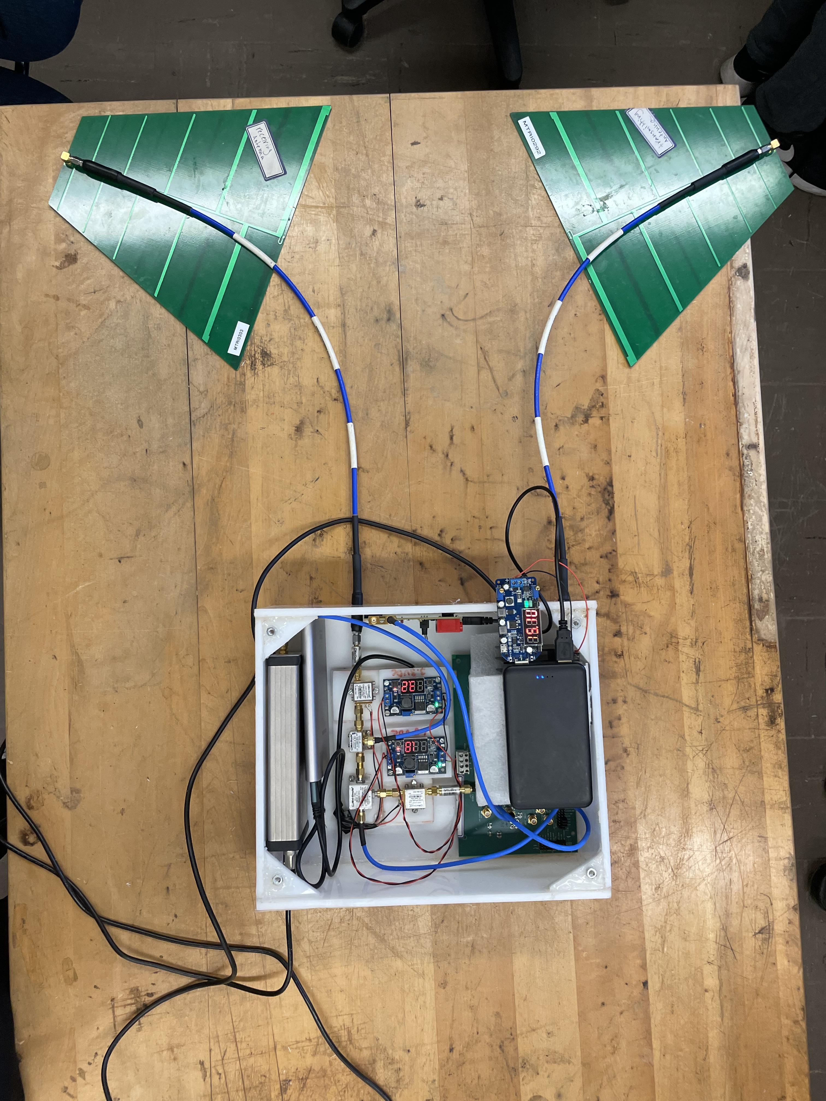
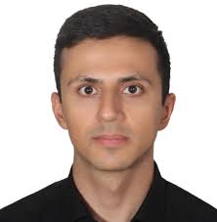

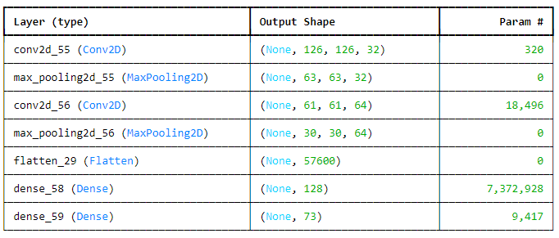
Drone Based Radar Intelligent Soil Sub-Surface Characterization
Joshua Thurber (DS), Nicholas Latsis (DS), Ethan Reed (DS)
Advisor: Professor Reza Zekavat (PH,DS), Professor Doug Petkie (PH)
Abstract
Intelligent Moisture Characterization via Drone-Based Radar Signal/Data Analysis
Measurement Setup
Developed setup is a simulation of Drone flight over the ground.
Results
Performance of Moisture Predicting CNN using Spectrograms and Moisture Probe Testing Data
CNN Learning Capabilities shown by learning curve with limited training and testing datasets showing a balance between learning and generalization
Problem Definition
•Optimal Irrigation of Farmland
(Avoid Water and Soil Mineral Waste)
Drone-based GPR Simulator Setup
Moisture Probe to measure ground moisture
Measurement Info
Waveform of Transmitted Signal
SFCW from
400MHz to 1.2 GHz. (Vector Signal Generator VSG25A)
QQ Plot of Residuals showing the distribution of error terms from the predictions of a CNN trained on a limited dataset. The alignment with the red line indicates that the residuals closely follow a normal distribution.
Future Works
Enrich Limited Moisture Probe and SFCW Dataset by measuring grounds with different textures to train a model with better prediction accuracy.
Use unsupervised ML methods to extract more features.
SoilX is offering MQPs during all terms of 2024/25
Transmitted and Received GPR Signal
Spectrum of Received Signals
(Real Time Spectrum Analyzer SA44B)
Creation of Root-Zone Moisture Map for Farmers
(KHz)
Accomplishments
Design of a ground penetrating radar (GPR)
Data Measurement Campaign (SFCW waveform)
Implemented SFCW Radar onto Mobile Drone
Developed a machine learning model with the data
Acknowledgements
Our research was funded by the USDA
Analysis Method
CNN Layers for Moisture prediction through radar data.
Saeed Haghniaz Jahromi for his mentorship
Allen Cheung for assisting with all drone flights

